Slide 1


Andy Tsai
2022/07/13

Slide 2

Outline
Executive Summary
Introduction
Methodology
Results
Conclusion
Appendix

Slide 3
Executive Summary
Summary of methodologies
Data are collected from SpaceX API and web scraping from SpaceX Wikipedia page
By using data visualization and create a dashboard, some insight can be found by figure.
Summary of all results
Top majority: to develop a model to predict successful Stage 1 recovery in order to lower the cost.
The machine learning model with best accuracy is KNN classification, with accuracy of 90.3%

Slide 4
Introduction
Project background and context
The commercial space age is coming. Offering space travel affordable for everyone may be feasible in recent future.
Some company has already launch their plan, such as Virgin Galactic and SpaceX
SpaceX is the benchmark in this field owing to lower rocket price
Problems you want to find answers
To built a company(SpaceY) which can compete with SpaceX, top majority is to train a model to predict successful Stage 1 recovery .

Slide 5

Section 1

Slide 6
Methodology
Executive Summary
Data collection methodology:
Data from SpaceX public API and Wikipedia page of SpaceX will be used in this project
Perform data wrangling
Convert landing outcomes(successful/ unsuccessful) into (1/0) class
Perform exploratory data analysis (EDA) using visualization and SQL
Perform interactive visual analytics using Folium and Plotly Dash
Perform predictive analysis using classification models
Machine learning methodologies, including Decision Tree Classifier, Logistic regression, KNN and SVM will be used.
GridSearchCV will be used to tuning model.

Slide 7
Data Collection
Describe:
Data were collected by two ways: SpaceX public API and Wikipedia page.
Selecting useful data and dealing with missing value will be down in this step.
The flow of collecting data from both ways are shown in following slides.

Slide 8
Data Collection – SpaceX API
Request data from SpaceX API
The flow chart of collecting data from SpaceX API show on right hand side.
The step can conclude with 2 points:
Query and select data
Clean data
Notebook: 1-jupyter-labs-spacex-data-collection-api.ipynb
Decode request data into .json
Normalize request(.json) into dataframe
Select specific column fron dataframe
('rocket', 'payloads', 'launchpad', 'cores' …)
Rescreen each column to extract useful data for analysis
Filter dataframe to only include Falcon 9 launches
Using mean value to deal with missing values

Slide 9
Data Collection - Scraping
Request Falcon9 Launch Wiki page
The flow chart of collecting data from Wikipedia page.
Data collect from wiki and SpaceX API will be used in later analysis.
Notebook: 2-jupyter-labs-webscraping.ipynb
Create a BeautifulSoup object from the HTML response
Find table with launch records from BeautifulSoup object
Create a data frame by parsing the launch HTML tables
Export above data to a CSV
9

Slide 10
Data Wrangling
How data were processed:
Import collected data
Outcome column expose two message: ‘Mission Outcome’ and ‘Landing Location’
We try to label the outcomes.
If mission success, then lable will be ‘1’,iIf mission fail, then lable will be ‘0’,
Therefore, [True ASDS, True RTLS, True Ocean] will be labeled as ‘1’, [None None, False ASDS, False Ocean, None ASDS, False RTLS] will be labeled as ‘0’.
Notebook: 3-labs-jupyter-spacex-Data wrangling.ipynb

Slide 11
EDA with Data Visualization
Summarize:
By using data visualization, the relation of successful rate with other properties (and other relationship) can be found.
Success rate generally increases over years.
Success rate is relative to orbit type.
Launch Site has its payload mass limit.
Payload mass is relative to orbit type.
Notebook: 4-jupyter-labs-eda-sql-coursera_sqllite.ipynb

Slide 12
EDA with SQL
Summary of SQL queries
Loaded data set from .db file
Find the names of the unique launch sites
Find 5 records where launch sites begin with `CCA`
Calculate the total payload carried by boosters from NASA
Calculate the average payload mass carried by booster version F9 v1.1
Find the dates of the first successful landing outcome on ground pad
Select boosters name with specific payload mass .
Notebook: 4-jupyter-labs-eda-sql-coursera_sqllite.ipynb

Slide 13
Build an Interactive Map with Folium
Summarize & explanation
Folium maps mark the important property on the map, such as Launch Sites, successful and unsuccessful landings, and a proximity distance to railway, highway, coast, and city.
Interactive map allows us to understand launch sites’ relative relationship in real world.
Notebook: 5-lab_jupyter_launch_site_location.ipynb

Slide 14
Build a Dashboard with Plotly Dash
Summarize & explanation
Dashboard includes two parts: a pie chart and a scatter plot.
A Range_Slider and a Dropdown items are added to select specific data.
The pie chart is used to visualize launch site success rate.
The scatter is used to see the relationship between launch sites, payload mass, and booster version category
Python script: 6-spacex_dash_app.py

Slide 15
Predictive Analysis (Classification)
Data Standardize
The flow chart of predictive analysis are shown on the right hand.
The KNN classification model (with best parameter found by GridSearchCV) come out with best accuracy.
Notebook: 7-SpaceX_Machine Learning Prediction_Part_5.ipynb
Split the data into train set and test set
Testing different classification model for prediction
Using GridSearchCV to find the best model parameter
Check R square and confusion matrix evaluate result
Using bar chart to comparing different model
15
15

Slide 16
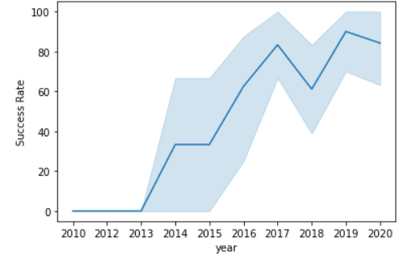
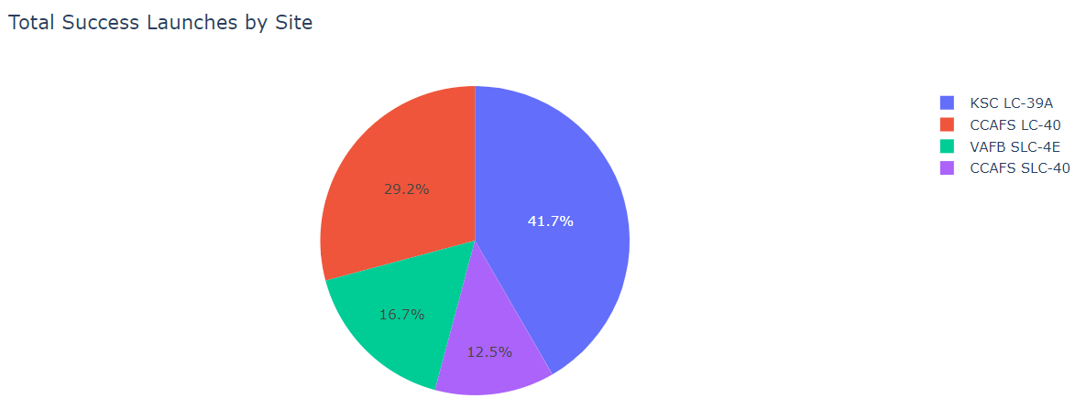
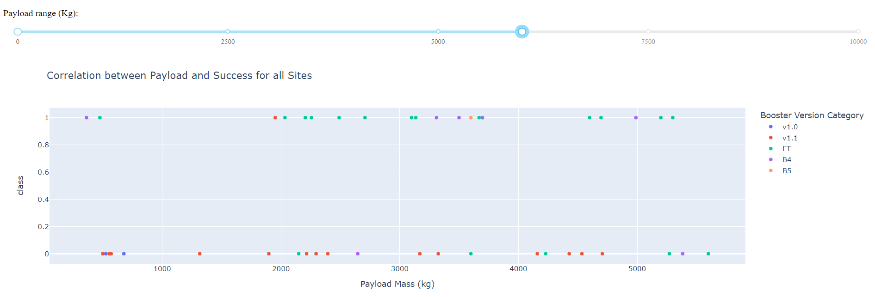
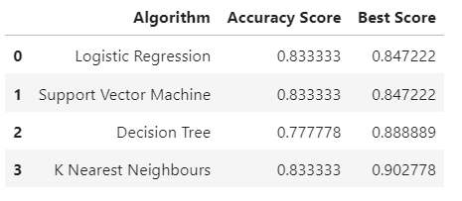
Results
Exploratory data analysis results
Interactive analytics demo in screenshots
Predictive analysis results

Slide 17

Section 2

Slide 18
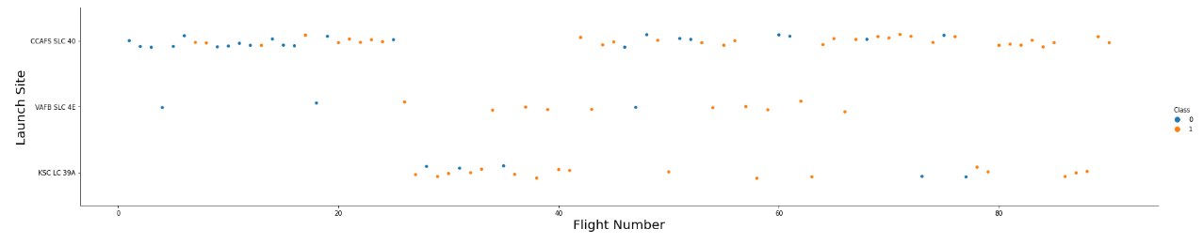
Flight Number vs. Launch Site
Scatter plot of Flight Number vs. Launch Site
Explanations
If flight number above 20, then successful rate rapidly increase.
Different launch sites have different success rates. CCAFS LC-40, has a success rate of 60 %, while KSC LC-39A and VAFB SLC 4E has a success rate of 77%.
CCAFS is the main launch site which has the highest flight number.

Slide 19
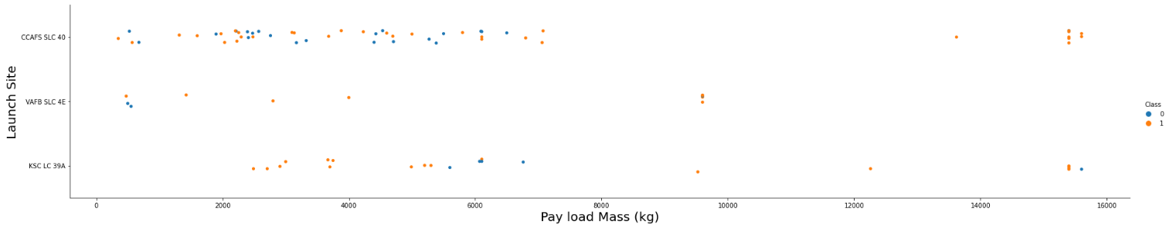
Payload vs. Launch Site
Scatter plot of Payload vs. Launch Site
Explanations
Launch sites VAFB SLC 4E’s max pay load mass is below 10000.
Most payload mass in a range of 0-6000 kg.

Slide 20
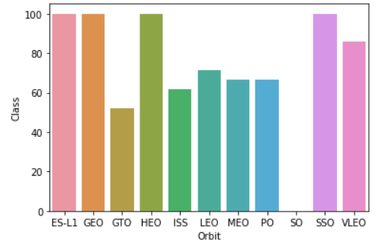
Success Rate vs. Orbit Type
Bar chart for the success rate of each orbit type
Explanations
SSO has 100% success rate with 5 sample.
ES-L1 , GEO , HEO have 100% success rate with only 1 sample
SO (1) has 0% success rate
GTO (27) has the around 50% success rate but largest sample

Slide 21
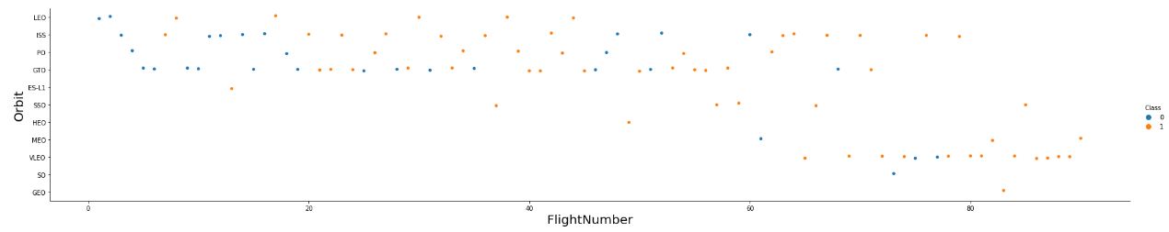
Flight Number vs. Orbit Type
Scatter point of Flight number vs. Orbit type
Explanations
With flight number become bigger, the success rate increase.
The later setting Orbit preferences(with bigger flight number) perforce better.
SpaceX appears to perform better in LEO or SO

Slide 22
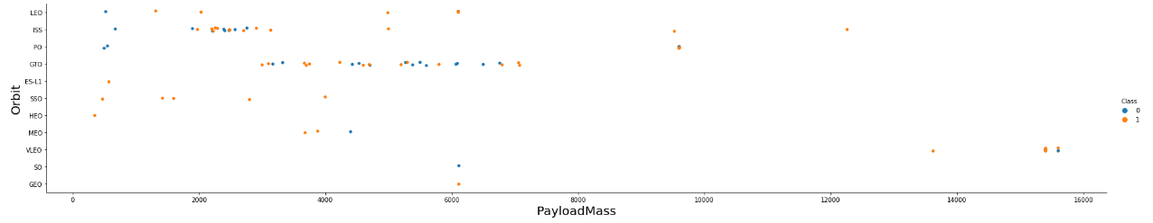
Payload vs. Orbit Type
Scatter point of payload vs. orbit type
Explanations
LEO and SSO seem to have relatively low payload mass
VLEO always com with largely higher payload then other orbit.

Slide 23
Launch Success Yearly Trend
Line chart of yearly average success rate
Explanations
Success rate generally increases over years.
Success rate only slight dip in 2018.
Success is above 80% in recent years.

Slide 24
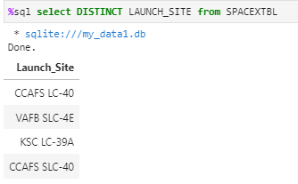
All Launch Site Names
Find the names of the unique launch sites
Present your query result with a short explanation here
4 launch site are listed in the right fig. They are:
CCAFS LC-40
VAFB SLC-4E
KSC LC-39A
CCAFS SLC-40

Slide 25
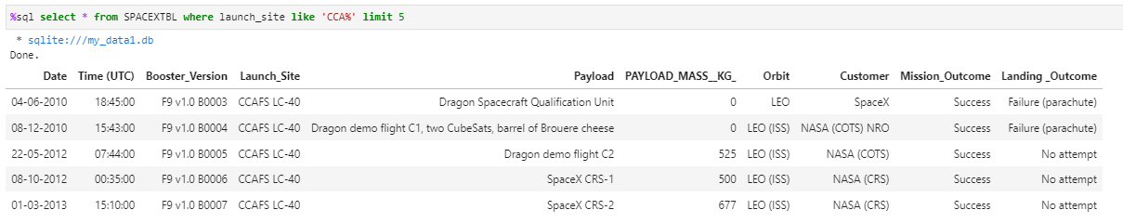
Launch Site Names Begin with 'CCA'
Find 5 records where launch sites begin with `CCA`
Present your query result with a short explanation here

Slide 26
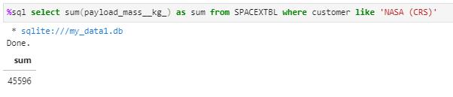
Total Payload Mass
Calculate the total payload carried by boosters from NASA
Present your query result with a short explanation here
The total payload carried by boosters from NASA is 45996 kg.

Slide 27
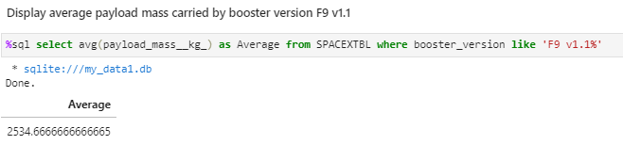
Average Payload Mass by F9 v1.1
Calculate the average payload mass carried by booster version F9 v1.1
Present your query result with a short explanation here
The average payload mass carried by booster version F9 v1.1 is about 2543.67 kg.

Slide 28
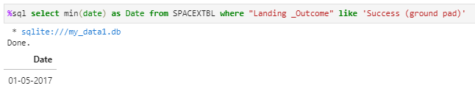
First Successful Ground Landing Date
Find the dates of the first successful landing outcome on ground pad
Present your query result with a short explanation here
The first successful landing outcome on ground pad is 2017/1/5

Slide 29
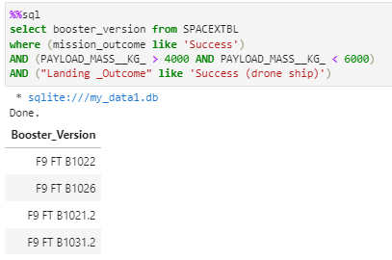
Successful Drone Ship Landing with Payload between 4000 and 6000
List the names of boosters which have successfully landed on drone ship and had payload mass greater than 4000 but less than 6000
Present your query result with a short explanation here
4 boosters name retrieve which have successfully landed on drone ship and had payload mass greater than 4000 but less than 6000

Slide 30
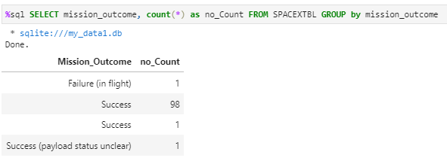
Total Number of Successful and Failure Mission Outcomes
Calculate the total number of successful and failure mission outcomes
Present your query result with a short explanation here
Mission successful outcomes is 100 times while there were 1 time payload status is unclear.

Slide 31
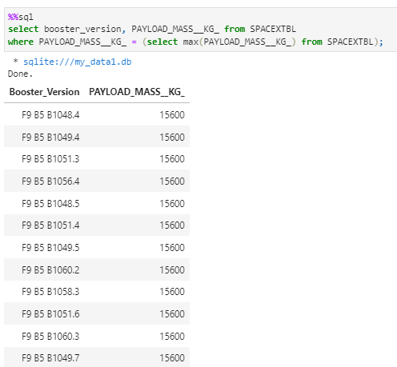
Boosters Carried Maximum Payload
List the names of the booster which have carried the maximum payload mass
Present your query result with a short explanation here
Table on the right hand shows the max payload mass is 15600.
These booster versions are all F9 B5 B10xx.x variety.

Slide 32
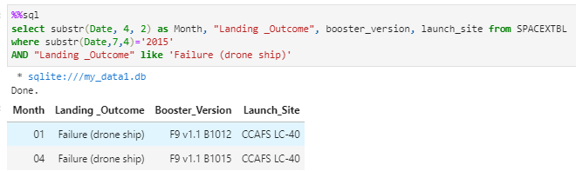
2015 Launch Records
List the failed landing_outcomes in drone ship, their booster versions, and launch site names for in year 2015
Present your query result with a short explanation here
2 failed landing_outcomes were queried in above condition.

Slide 33
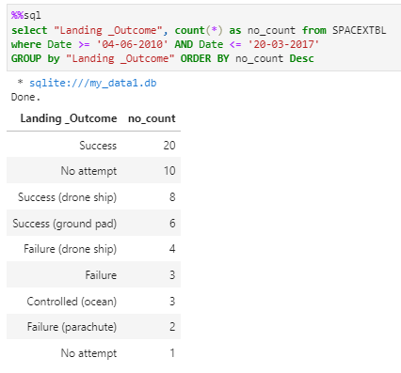
Rank Landing Outcomes Between 2010-06-04 and 2017-03-20
Rank the count of landing outcomes (such as Failure (drone ship) or Success (ground pad)) between the date 2010-06-04 and 2017-03-20, in descending order
Present your query result with a short explanation here
This query returns a list of landings outcomes between 2010-06-04 and 2017-03-20.
There are total 8 types of result and can category into 3 types:
Success: including [Success, Success (drone ship), Success (ground pad)]
Failure: including [Failure, Failure (drone ship), Failure (parachute)]
Other: including [No attempt, Controlled (ocean)]

Slide 34

Section 3

Slide 35
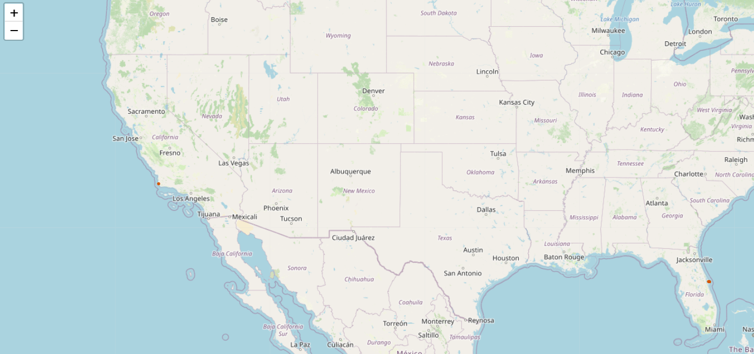
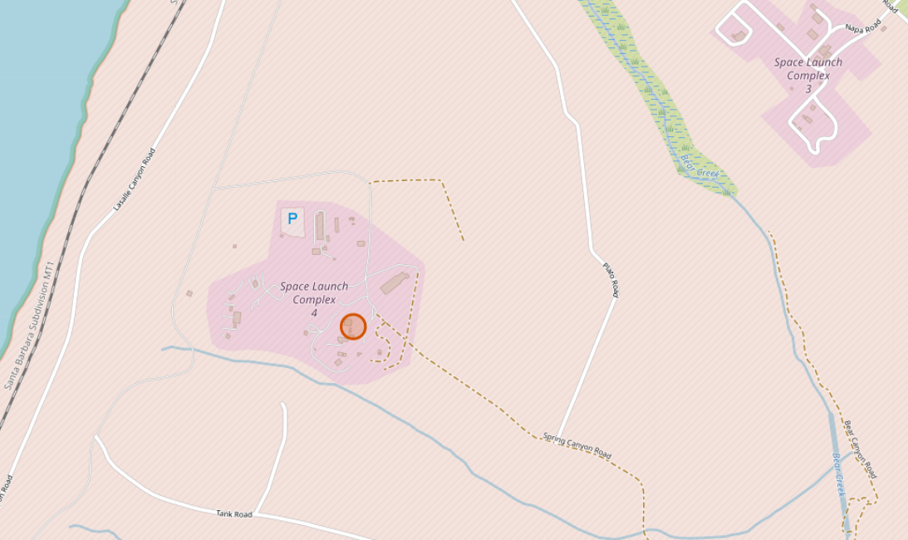
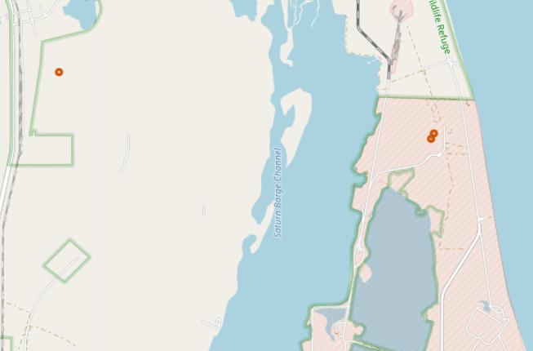
All launch sites’ location on map
Important elements and findings:
Only 1 launch site on west coast, most launch site on east coast.
All launch site near the sea.

Slide 36
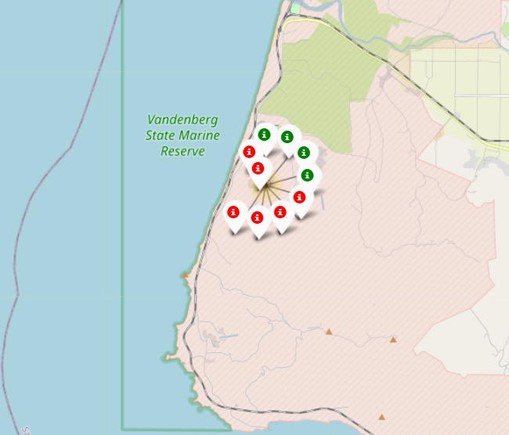
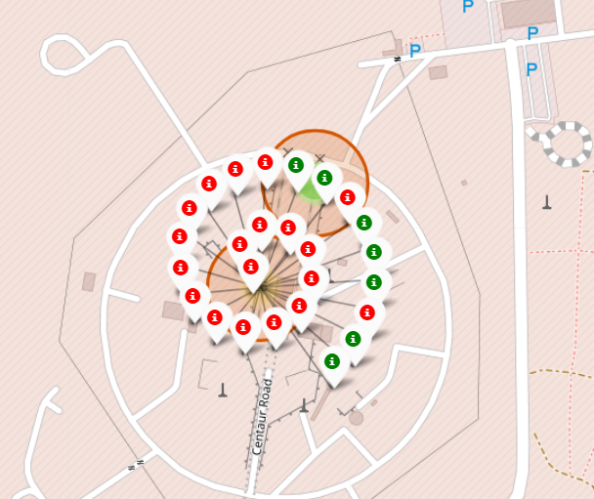
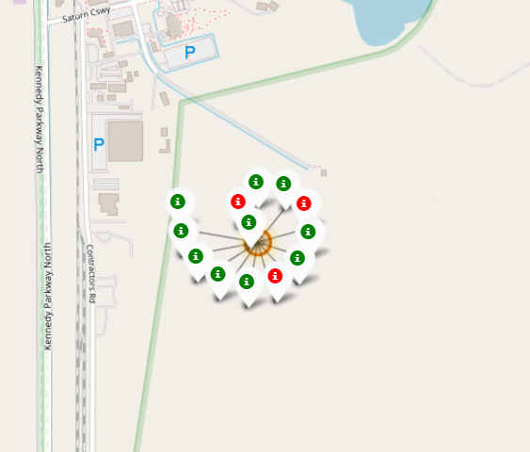
Map of color-labeled launch outcomes
Important elements and findings:
By using clusters, launch outcome of each site can be visualize
In the figure above, green icon means successful landing while red icon means failed landing.

Slide 37
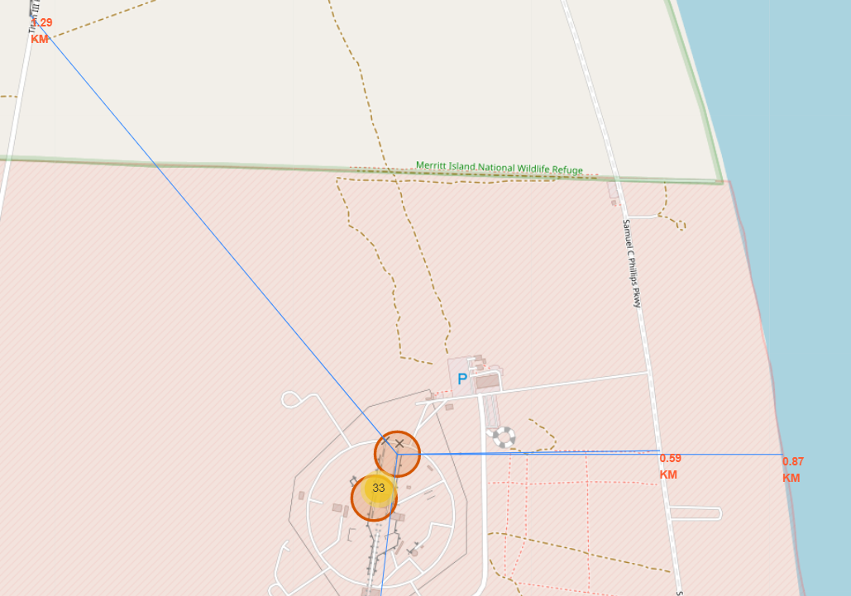
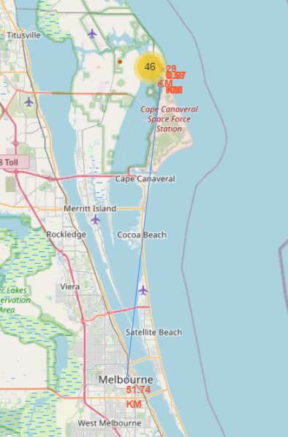
Distance to key location
Important elements and findings, take CCAFS SLC-40 as example:
Launch sites are close to railways, highways.
Launch sites are close to coasts.
Launch sites are relative far from populated areas.

Slide 38

Section 4

Slide 39
Pie chart of total success by launches site
Important elements and findings:
KSC LC-39A account for the highest success amount (41.7%) in all launches site.
CCAFS SLC-40 account for the lowest success amount(12.5) in all launches site.

Slide 40
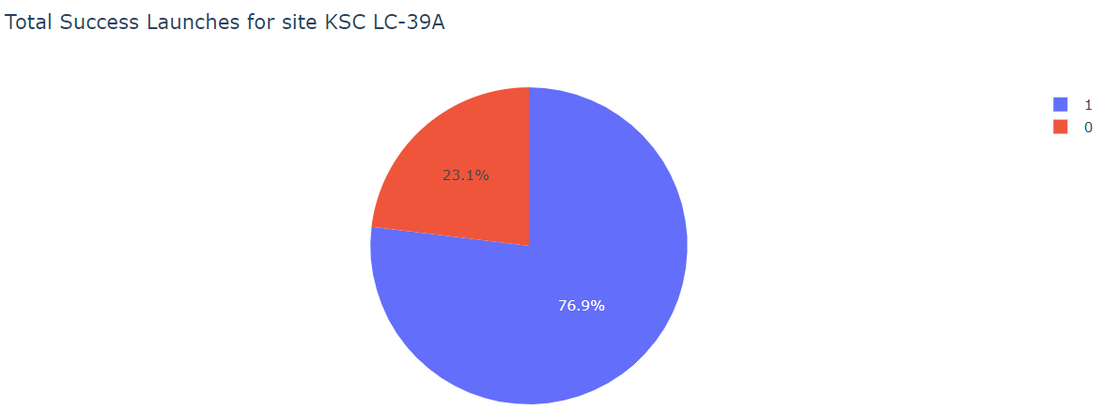
Pie chart for launch site with highest launch success ratio
Important elements and findings:
KSC LC-39A has the highest success rate(76.9%)

Slide 41
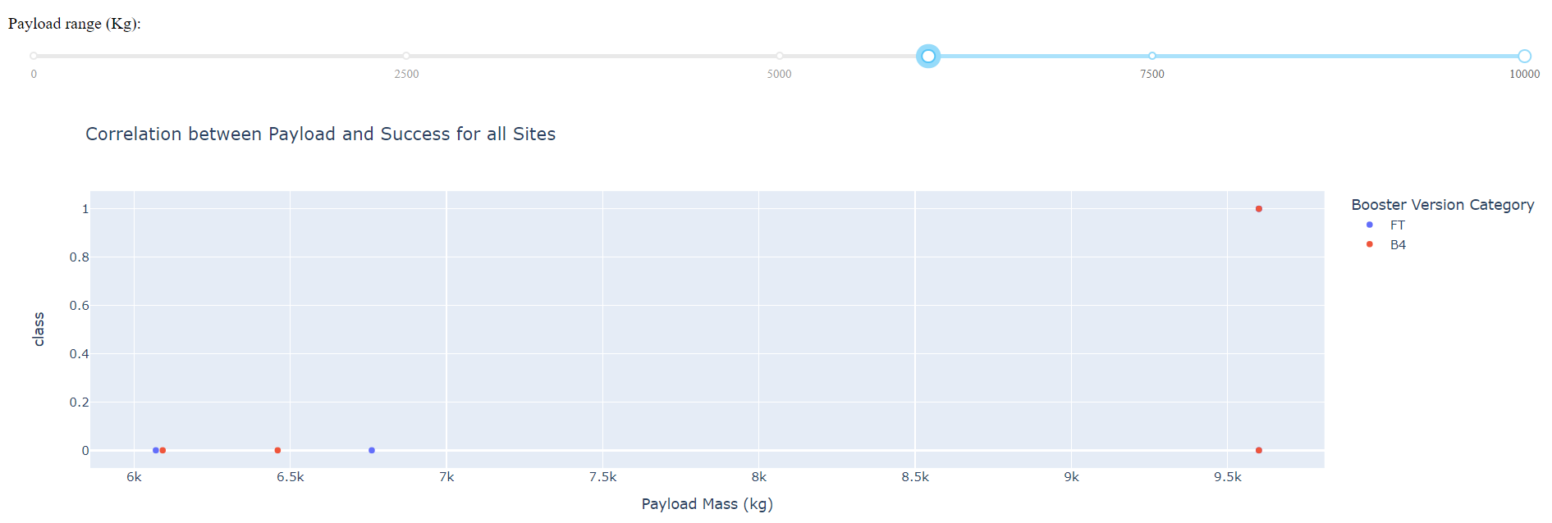
Payload vs. Launch Outcome scatter plot for all sites
Important elements and findings:
In payload range [6000~10000 kg], almost all the launch outcome is false
On the other hands, in payload range [0~6000 kg], the launch outcome become successful more often.

Slide 42

Section 5

Slide 43
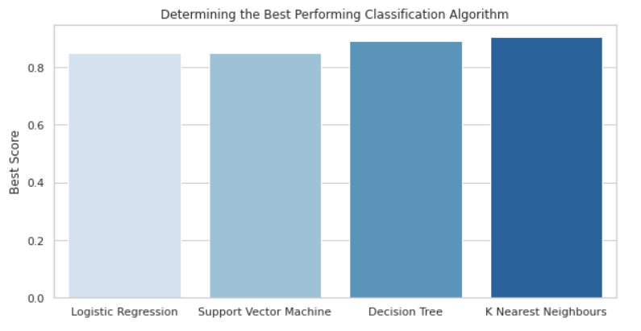
Classification Accuracy
Visualize the built model accuracy for all built classification models, in a bar chart
Find which model has the highest classification accuracy
At the condition of [test_size=0.2, random_state=2] and using gridsearch_cv to find the best score, KNN has the highest classification accuracy
The best score is 0.903

Slide 44
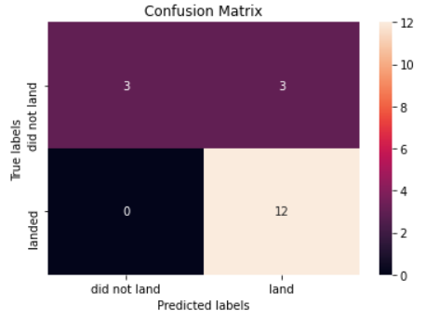
Confusion Matrix
Show the confusion matrix of the best performing model with an explanation
KNN models predicted 12 successful landings when the true label was successful landing.
KNN models predicted 3 unsuccessful landings when the true label was unsuccessful landing.
KNN models predicted 3 successful landings when the true label was unsuccessful landings (false positives).

Slide 45
Conclusions
Our task: To built a company(SpaceY) which can compete with SpaceX
Top majority: to develop a model to predict successful Stage 1 recovery in order to lower the cost.
Data are collected from SpaceX API and web scraping from SpaceX Wikipedia page
By using data visualization and create a dashboard, some insight can be found by figure.
The machine learning model with best accuracy is KNN classification, with accuracy of 90.3%
If more data or features can be collected or consider, the machine learning model may improve its accuracy.

Slide 46
Appendix
Author's GitHub: https://github.com/CKMaxwell

Slide 47


